Slide 1
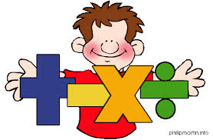
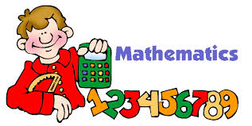
Thinking is at the heart of Mathematics and therefore should be at the heart of mathematical teaching and learning.

Slide 2
Aims of today
To get an insight into how Maths is taught at Belton All Saints Church of England Primary School.
To provide information on the reasoning and mastery approach in the new curriculum.
To work alongside pupils and take part in a variety of maths activities.

Slide 3
The New Maths Curriculum
Children should:
Become fluent in the fundamentals of mathematics so that they develop conceptual understanding and the ability to recall and apply knowledge rapidly and accurately.
Reason mathematically by following a line of enquiry, finding relationships and generalisations and developing a justification or proof using mathematical language.
Solve problems by applying their mathematics to a variety of problems with increasing sophistication, including breaking down problems into a series of simpler steps and persevering in seeking solutions.

Slide 4
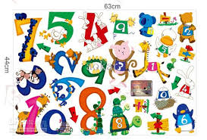
Number Sense!
Children need to understand our number system, starting with counting numbers, building an understanding of how our numbers work and fit together. This includes exploring place value and comparing and ordering numbers then applying this understandingin different contexts.
In all areas children need
to experience the
CONCRETE, PICTORAL
& ABSTRACT

Slide 5
Year Group | Objective | Reasoning Tasks
Year 1 | Read, write and interpret mathematical statements involving addition (+), subtraction (-) and equals (=) signs (appears also in Written Methods) | Fact families Which four number sentences link these numbers? 12, 15, 3 | What else do you know? If you know this: 12 – 9 = 3 what other facts do you know? | Missing symbols Write the missing symbols ( + - =) in these number sentences: 17 3 20 18 20 2
Year 2 | Show that addition of two numbers can be done in any order (commutative) and subtraction of one number from another cannot | Fact families Which four number sentences link these numbers? 100, 67, 33 | What else do you know? If you know this: 87 = 100 – 13 what other facts do you know? | Missing symbols Write the missing symbols (+ - =) in these number sentences: 80 20 100 100 70 30 87 13 100
Year 3 | estimate the answer to a calculation and use inverse operations to check answers | Making an estimate Which of these number sentences have the answer that is between 50 and 60 174 - 119 333 – 276 932 - 871 | Always, sometimes, never Is it always, sometimes or never true that if you subtract a multiple of 10 from any number the units digit of that number stays the same. Is it always, sometimes or never true that when you add two numbers together you will get an even number | Always, sometimes, never Is it always, sometimes or never true that when you add two numbers together you will get an even number

Slide 6
Year Group | Objective | Reasoning Tasks
Year 4 | Estimate and use inverse operations to check answers to a calculation | Making an estimate Which of these number sentences have the answer that is between 550 and 600 1174 - 611 3330 – 2779 9326 - 8777 | Always, sometimes, never Is it always sometimes or never true that the difference between two odd numbers is odd. | Encouraging reasoning Convince me Explain Another example True or false Other possibilities What else do you know?
Year 5 | Use rounding to check answers to calculations and determine, in the context of a problem, levels of accuracy | Making an estimate Which of these number sentences have the answer that is between 0.5 and 0.6 11.74 - 11.18 33.3 – 32.71 | Always, sometimes, never Is it always, sometimes or never true that the sum of four even numbers is divisible by 4. | Encouraging reasoning Convince me Explain Another example True or false Other possibilities What else do you know?
Year 6 | Use estimation to check answers to calculations and determine, in the context of a problem, levels of accuracy. | Making an estimate Circle the number that is the best estimate to 932.6 - 931.05 1.3 1.5 1.7 1.9 | Always, sometimes, never Is it always, sometimes or never true that the sum of two consecutive triangular numbers is a square number | Encouraging reasoning Convince me Explain Another example True or false Other possibilities What else do you know?

Slide 7
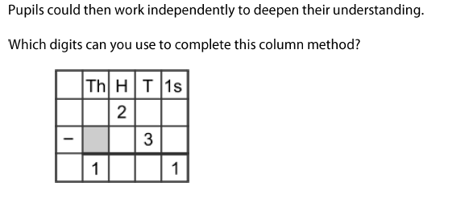
Deepening understanding

Slide 8
Deepening understanding

Slide 9
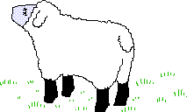
Heads and Feet
On a farm there were some hens and sheep.
Altogether there were 8 heads and 22 feet.
How many hens were there?
How many legs would eight hens have? How many legs would eight sheep have? What if there were 24 feet? What combinations would work?

Slide 11
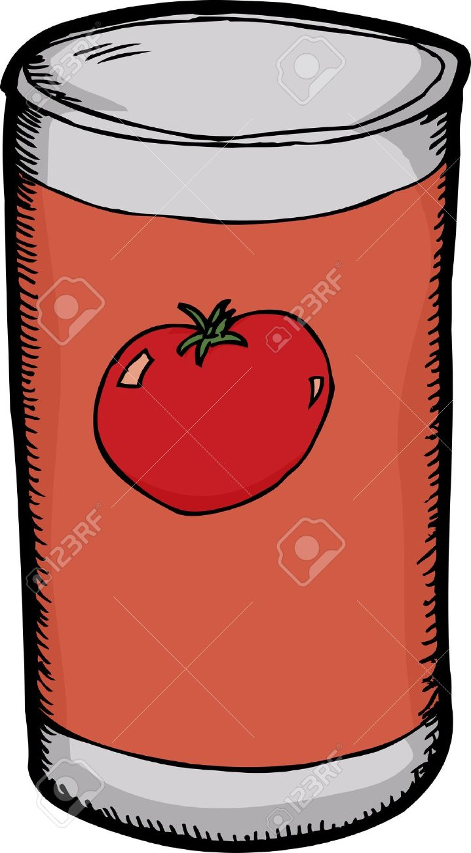
Shopping!

Slide 12
Other Information
Rising Stars Scheme
I Am Learning
Topmarks Website
NRICH
Doodle Maths
Woodlands Maths Zone
Mrs Device

